Slide 1
Deep Short Text Classification
with Knowledge Powered Attention
Advisor : Jia-Ling, Koh Speaker : Ya-Fang, Hsiao
Source : arXiv.org
Date : 2019/04/01

Slide 2
1
Introduction
CONTENTS
2
Related Works
3
Model
4
Experiment
5
Conclusion

Slide 3
1
Introduction
PART

Slide 4
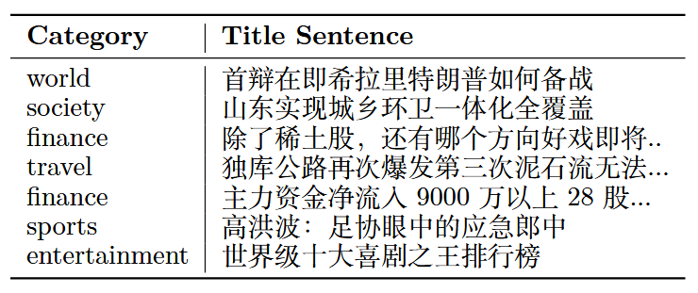
1 Introduction
Short Text Classification
Explicit representation
Deep Short Text Classification
with Knowledge Powered Attention
Represented explicit feature as a sparse vector, using syntactic information.
O : interpretable, easy to understand
X : ignore context, cannot capture deep semantic information
Integrate together
Implicit representation
Based on deep neural networks, mapped into an implicit space.
O : good at capturing syntax and semantic information
X : poor on new and rare words, ignore important relations

Slide 5
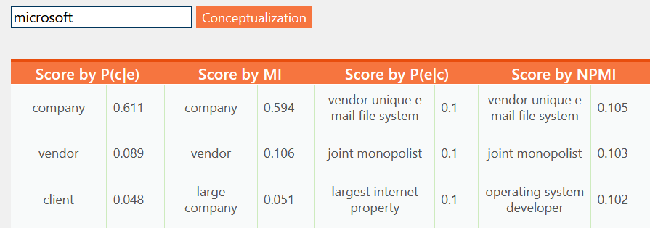
1 Introduction
with Knowledge
Enrich the semantic representation with knowledge bases (KBs).
Conceptualization : the process of retrieving the conceptual information (associate each short text with its relevant concepts) form KBs.
Deep Short Text Classification
with Knowledge Powered Attention

Slide 6
2
Related Works
PART

Slide 7
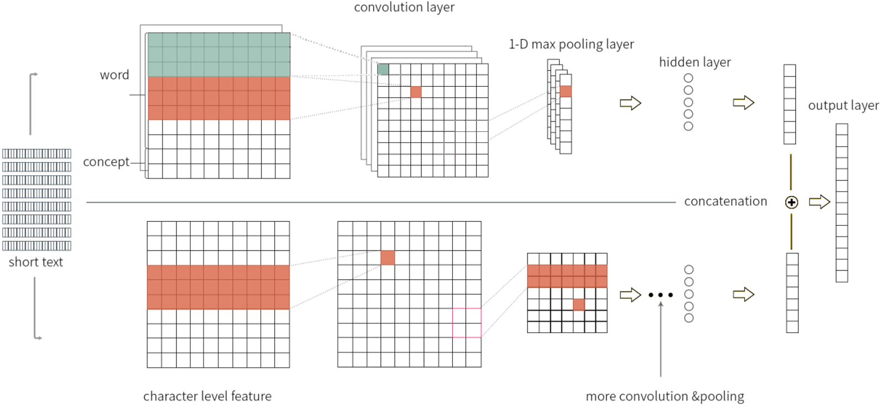
2 Related Works
Combining Knowledge with Deep Convolutional
Neural Networks for Short Text Classification
Wang et al. 2017
Word-concept embedding
Character-level embedding
Kim, 2014 Convolutional Neural Networks for Sentence Classification
Kim et al., 2016 Character-aware neural language models

Slide 8
2 Related Works
Problem1.
Improper concepts are easily introduced due to the ambiguity of entities in KBs.
Ex : “Alice has been using Apple for more than 10 years”
Acquire the concepts “fruit” and “mobile phone” of “apple” from KB.
To solve the problem …
Deep Short Text Classification with
Knowledge Powered Attention (STCKA)
Concept towards Short Text attention (C-ST) :
measure the semantic similarity between a short text and its corresponding concepts.

Slide 9
2 Related Works
Problem2.
It is necessary to take into account the granularity and relative importance of the concepts.
Ex : “Bill Gates is one of the co-founders of Microsoft”
Retrieve the concepts “person” and “entrepreneur” of “Bill Gates” from KB.
To solve the problem …
Deep Short Text Classification with
Knowledge Powered Attention (STCKA)
Concept towards Concept Set attention (C-CS) :
Explore the importance of each concept with respect to the whole concept set.

Slide 10
3
Model
PART

Slide 11
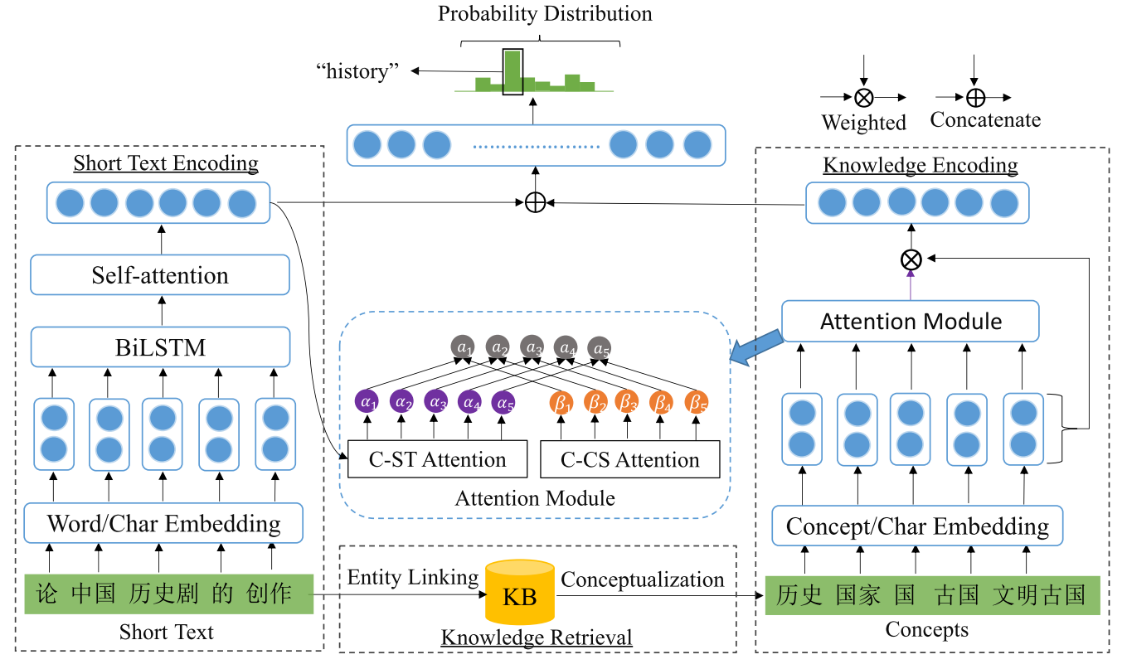
Short Text Classification with
Knowledge Powered Attention
Model 3

Slide 12
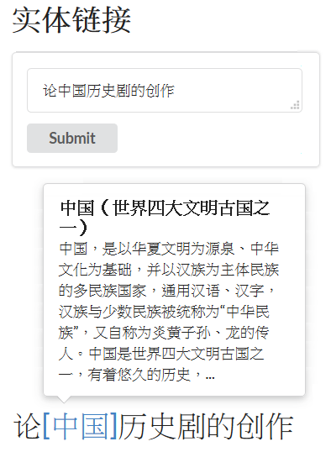
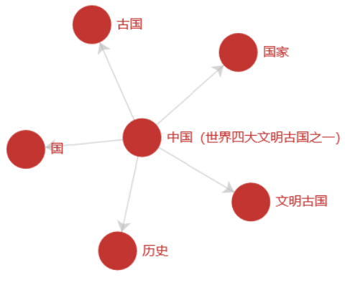
Knowledge Retrieval
Model 3
1. Entity linking : acquire an entity set $ε$
2. Conceptualization : for each entity,
acquire its conceptual information from CN-Probase

Slide 13
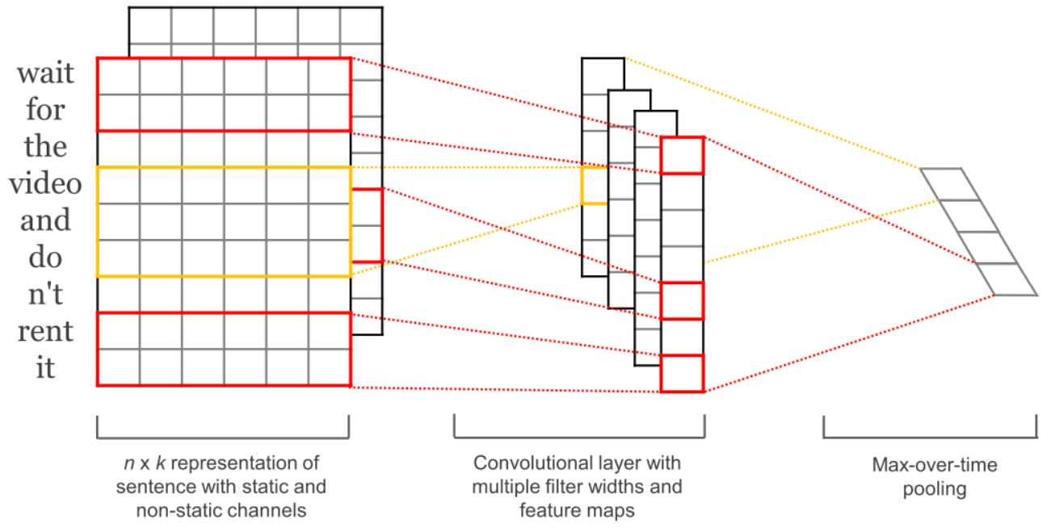
Input Embedding
Model 3
($\frac{d}{2}$-dimensional)
$$d$$
$$d$$
Pre-trained word vectors
($\frac{d}{2}$-dimensional)

Slide 14
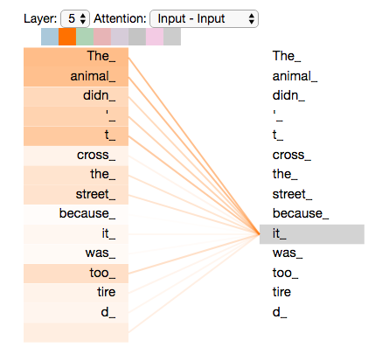
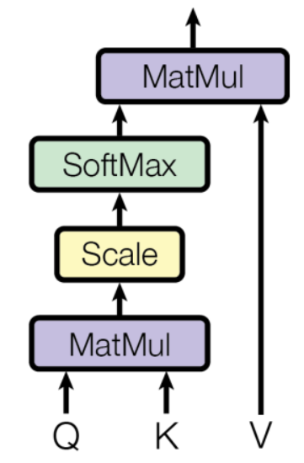
Short Text Encoding
Model 3
$$q∈ℝ^{2u}$$
Scaled Dot-Product Attention
Max-pooling
$$H∈ℝ^{n×2u}$$
$A=Attention\left(Q,K,V\right)$
$=softmax(\frac{QK^{T}}{\sqrt{2u}})V$
$$n$$
$$d$$

Slide 15
Knowledge Encoding
Model 3
Concept towards Concept Set attention (C-CS) :
Source2token self-attention :
$β_{i}=softmax(w_{2}^{T}tanh(W_{2}c_{i})+b_{2})$
Concept towards Short Text attention (C-ST) :
Vanilla attention :
$α_{i}=softmax(w_{1}^{T}tanh(W_{1}\left[c_{i};q\right]+b_{1}))$
Concept towards Short Text attention (C-ST) :
Reduce the bad influence of
improper concepts introduced.
$$p=\sum_{i=1}^{m}{𝒶_{i}c_{i}}$$
$\left.𝒶_{i}=softmax(γα_{i}+(1−γ)β_{i}\right)$
$$γ=σ\left(w^{T}\left[α;β\right]+b\right)∈\left[0, 1\right]$$
$$p$$
$$q$$
$$W_{1}∈ℝ^{d_{a}×(d+2u)}$$
$$W_{2}∈ℝ^{d_{b}×d}$$
$$𝒶_{i}$$
$$c_{i}$$
$$c_{i}$$
$$c_{i}$$
Concept towards Concept Set attention (C-CS) :
Take the relative importance of the concepts.

Slide 16
Short Text Classification with
Knowledge Powered Attention
Model 3
Training :
$φ↦\sum_{s∈S}{logp(y|s,φ)}$

Slide 17
4
Experiment
PART

Slide 18
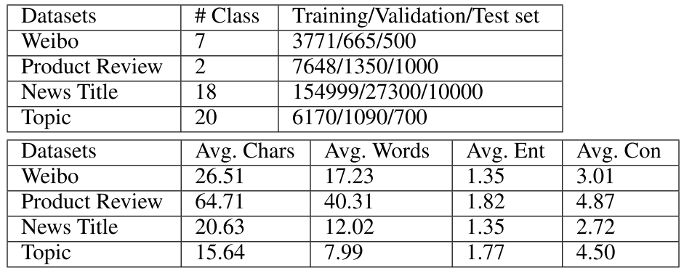
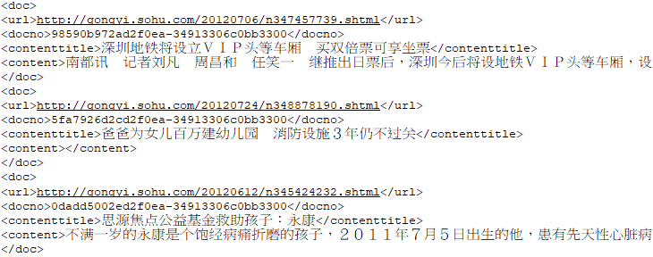
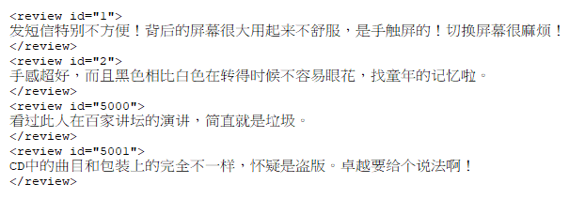
Dataset
Experiment 4

Slide 19
Results
Experiment 4
Evaluation metric : Accuracy

Slide 20
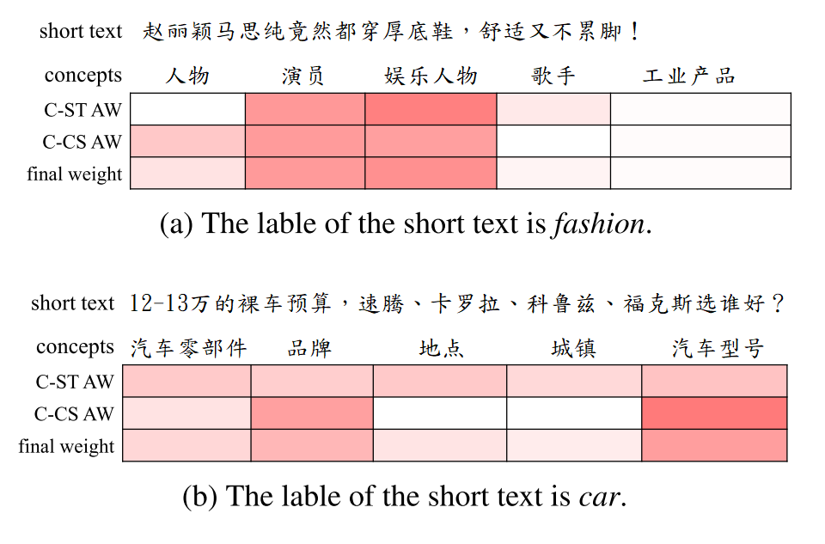
Effectiveness of Attention
Experiment 4
$$\left.𝒶_{i}=softmax(γα_{i}+(1−γ)β_{i}\right)$$

Slide 21
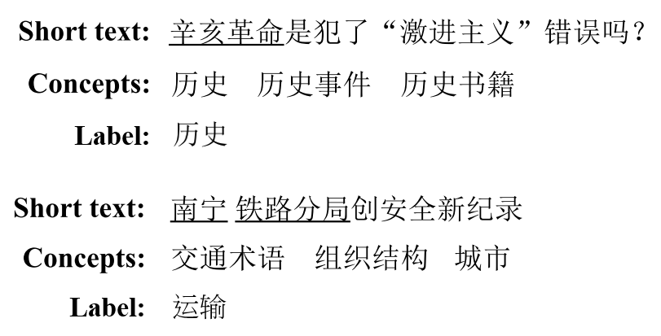
Power of Knowledge
Experiment 4

Slide 22
5
Conclusion
PART

Slide 23
5 Conclusion
1. Enhance the representation of short texts with conceptual information.
2. Measure the similarity between each concept and a short texts (C-ST).
3. Explore the importance of each concept from whole concept set (C-CS).
4. Adaptively learned a soft switch to combine attention weights on different datasets.
5. Make full use of character and word level features and employ self-attention to
generate the short text representation.
6. Results show that STCKA outperforms the state-of-the-art methods.

